Slide 1
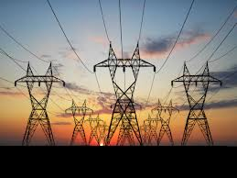
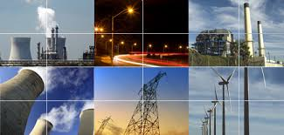

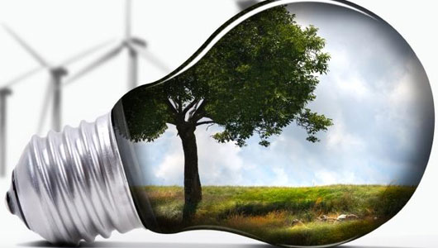

BENEFITS OF ENERGY EFFICIENT APPLIANCES

Slide 2
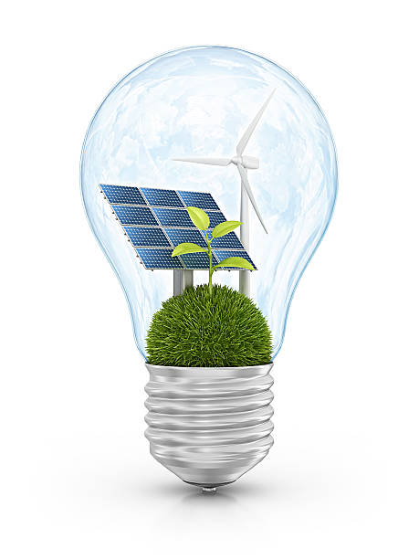
As technological advances continue, our society has become dependent on various appliances to make our lives easier. As amazing as these appliances are, they need a lot of energy. That is why innovators have developed highly energy-efficient appliances.
Energy-efficient appliances help save money and energy and contribute to a more environmentally friendly lifestyle.
Choosing the right energy-efficient appliances for your home can significantly reduce your utility bills and carbon footprint.

Slide 3
How Energy-Efficient Appliances Work
Energy-efficient appliances can maximize small amounts of energy into the required energy needed to complete a task.
Many of these appliances can operate under lower temperature and energy settings, which sustain their functionality until the task is completed.

Slide 4
Main benefits of energy-efficient appliances
Energy Saving:
Since energy-efficient appliances spend the minimum energy to complete their tasks, they can enhance energy conservation. This conserved energy can then be used in the home or workplace for a different purpose.
2. Money Saving:
These appliances also work toward reducing energy bills by saving energy. This can be achieved by:
Buying Star rated appliances – this can help save up to 30% on electricity bills.
Replacing incandescent light bulbs – energy-efficient halogens, CFLs, or LEDs can help save 30-80% on energy bills.

Slide 5
Main benefits of energy-efficient appliances
3. Environmentally Friendly
Using energy-efficient appliances minimizes the exploitation of natural resources such as natural gas, oil, coal, and water.
Energy efficiency enhances the conservation of these resources to achieve sustainable development.
Energy-efficient appliances can also help control pollution because using water, oil, coal, and natural gas can lead to water, soil, and air pollution through industrial effluents and emissions.

Slide 6
Some of the different types of energy-efficient appliances include:
Refrigerators
Air conditions,
Water heaters
Lighters
Dishwashers
Washing machines
Dryers

Slide 7
FEATURES TO LOOK FOR WHEN SHOPPING FOR ENERGY-EFFICIENT APPLIANCES:
1. ENERGY RATING
Look for appliances with a high energy rating. The energy rating label provides information about the energy efficiency of the appliance, with higher ratings indicating greater energy efficiency
2. SMART APPS AND TECHNOLOGY
Consider appliances that have smart features and technology. These appliances can be connected to your smartphone or home automation system, allowing you to monitor and control your energy usage remotely.

Slide 8
FEATURES TO LOOK FOR WHEN SHOPPING FOR ENERGY-EFFICIENT APPLIANCES:
3. RENEWABLE ENERGY SOURCES
Look for appliances that can be powered by renewable energy sources.
Some appliances, such as solar-powered water heaters or wind-powered generators, can utilise clean and renewable energy to operate.
By using renewable energy sources, you can further reduce your carbon footprint and dependence on fossil fuels.

Slide 9
FEATURES TO LOOK FOR WHEN SHOPPING FOR ENERGY-EFFICIENT APPLIANCES:
4. UP-TO-DATE TECHNOLOGY
Choose appliances that incorporate the latest energy-saving technologies.
Manufacturers are constantly improving the energy efficiency of their appliances, so look for models that feature advanced technologies, such as improved insulation, variable speed motors, or advanced control systems.
These advancements can help reduce energy consumption and increase overall efficiency.

Slide 10

ENERGY SAVED IS ENERGY GENERATED
Energy conservation is the foundation of energy independence.
-Tom Allen

